Slide 1
Mathematics + Programming
Day 2

Slide 2
Property of Modular Arithmetic
a ≡ a (mod m)
If a ≡ b (mod m) and b ≡ c (mod m), then a ≡ c (mod m)
If a ≡ b (mod m), then b ≡ a (mod m)
If a ≡ b (mod m) and c ≡ d (mod m), then a + c ≡ b + d (mod m) and a - c ≡ b - d (mod m)
If a ≡ b (mod m), then for any integer ka ≡ kb (mod m)
If a ≡ b (mod m) and c ≡ d (mod m), then ac ≡ bd (mod m)
We have a ≡ b (mod m_{i}), i = 1, .., k, if and only if
a ≡ b (mod lcm(m₁, …, m_{k})

Slide 3
Group Discussion
How many numbers between 1 to 15 which are relatively prime to 15?
Can you find a simple way to do it?
2 numbers, a and b, are relatively prime if their Greatest Common Divisor (GCD) is 1
GCD of a and b is the largest number that divides both a and b

Slide 4
Inclusion-exclusion Principle
Include the cardinalities of the sets.
Exclude the cardinalities of the pairwise intersections.
Include the cardinalities of the triple-wise intersections.
Exclude the cardinalities of the quadruple-wise intersections.
Include the cardinalities of the quintuple-wise intersections.
Continue, until the cardinality of the n-tuple-wise intersection is included (if n is odd) or excluded (n even).

Slide 5

Euler Totient Function
Where p is the prime factor of n
Euler Totient Function is the foundation of RSA Algorithm

Slide 6
Fermat Little Theorem
a^{p} = a (mod p), where p is prime number
If a is not divisible by p, then a^{p-1} = 1 (mod p)

Slide 7
Modular Exponentiation
One step towards computing 2019^2019^2019^...

Slide 8
Computing Modular Exponentiation
Modular exponentiation is a type of exponentiation performed over a modulus. It is useful in computer science, especially in the field of public-key cryptography, such as RSA
Method:
Using Repeating sequence
Using fermat little theorem
Using euler Totient Function
Chinese Remainder Theorem

Slide 9
Go from basic: Repeating Sequence
Find the result of:
Last digit of 13⁵⁷?
24¹⁰ mod 18?
31¹⁰¹ mod 9?

Slide 10
Repeating Sequence
There exist repeated sequence of c in a^{x} = c (mod n) within n/gcd(a,n)-1 consecutive values of x
3⁰ ≡ 1 (mod 10)
3¹ ≡ 3 (mod 10)
3² ≡ 9 (mod 10)
3³ ≡ 7 (mod 10)
3⁴ ≡ 1 (mod 10)
3⁵ ≡ 3 (mod 10)
2¹ ≡ 2 (mod 10)
2² ≡ 4 (mod 10)
2³ ≡ 8 (mod 10)
2⁴ ≡ 6 (mod 10)
2⁵ ≡ 2 (mod 10)
7¹ ≡ 7 (mod 10)
7² ≡ 9 (mod 10)
7³ ≡ 3 (mod 10)
7⁴ ≡ 1 (mod 10)
7⁵ ≡ 7 (mod 10)
7⁶ ≡ 9 (mod 10)

Slide 11
Go from basic: Fermat Little Theorem
What is the result of 11¹¹⁷ mod 113?

Slide 12
Fermat Little Theorem
Fermat Little Theorem states that a^{p-1} = 1 (mod p),
where p is any prime number and a not multiple of p
In other words, for any numbers not multiple of p, the modulo sequence will repeat every p-1 times

Slide 13
Go from basic: Euler Totient Function
What is the last 2 digits of 67²³²⁷?

Slide 14
Euler Totient Function
Euler Totient Function states that a^{φ(n)} = 1 (mod n),
Where a and n are relatively prime
In other words, for any numbers which are relatively prime with p, the modulo sequence will repeat every φ(n) times

Slide 15
Go from basic: Chinese Remainder Theorem
What is the last 2 digits of 76²³²⁷?

Slide 16
Chinese Remainder Theorem
X = a mod b
Let b can be factored to b₁ b₂ … b_{n} where b_{i}’s are relatively prime to each other, then we can find X by solving
X = a mod b₁
X = a mod b₂
…
X = a mod b_{n}

Slide 17
Now let’s solve this
Compute 2019^2019^2019^...

Slide 18
RSA
Choose two primes p1 and p2 and let n=p1*p2
Let e∈Z be positive such that gcd(e,φ(n))=1.
Compute a value for d∈Z such that de≡1(modφ(n)).
Our public key is the pair (n,e) and our private key is the triple (p,q,d).
For any non-zero integer m<n, encrypt m using c≡m^{e}(modn).
Decrypt c using m≡c^{d}(modn).

Slide 19
RSA Explanation
Find d and e such that m^{d.e} = 1 (mod n)
By Euler Totient Function Theorem, de = k.φ(n) + 1

Slide 20
Code Demo

Slide 21
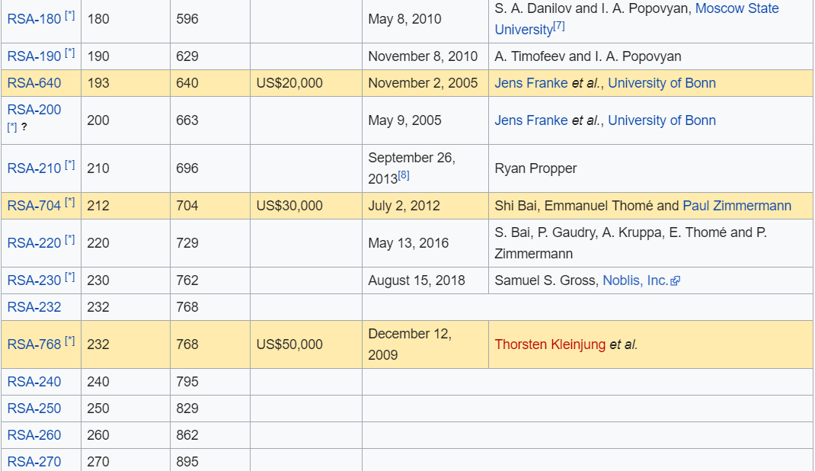
Factoring RSA

Slide 22
Additional Problem
Solve using concepts or algorithm that you know

Slide 23
2019 Trailing Zeros
What is the number of trailing zeros of 2019!

Slide 24
Q&A

Slide 25
End of the workshop
Thanks for participating and see you all around :)

